Slide 1
Forecasting COVID-19 Trends in 2021: Comparing RNNs and Time-Series Transformers
Yusuf Elnady, Haider Ali
CS 5814 – Intro to Deep Learning

Slide 2
Problem Statement
Datasets
Pipeline
Models and Baselines
Evaluation Metrics
Results
Future Work
2

Slide 3
Problem Statement
Forecasting the expected number of confirmed cases in USA in 2021 (per state).
Forecasting the expected number of death cases in USA in 2021 (per state).
Forecasting the expected number of vaccinated people in USA in 2021 (per state).
Comparing different time-series models.
RNNs, Time-Series Transformer (TST), SARIMA, and Prophet.
Predicting the date that all people in the United States (per state) will be vaccinated.

Slide 4
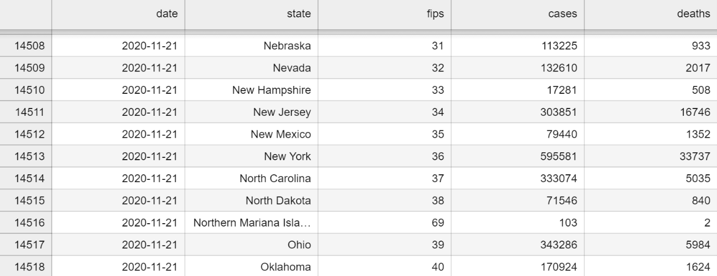
Dataset (Cases and Deaths)
https://github.com/nytimes/covid-19-data (Updated Daily)
From 2020-01-21 up to today.

Slide 5
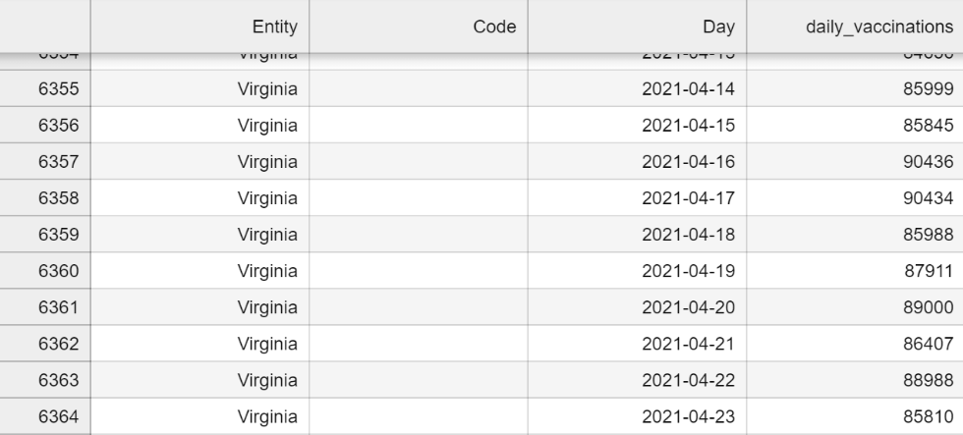
Dataset (Vaccinations)
https://ourworldindata.org/us-states-vaccinations (Updated Daily)
From 2020-12-21 up to today.

Slide 6
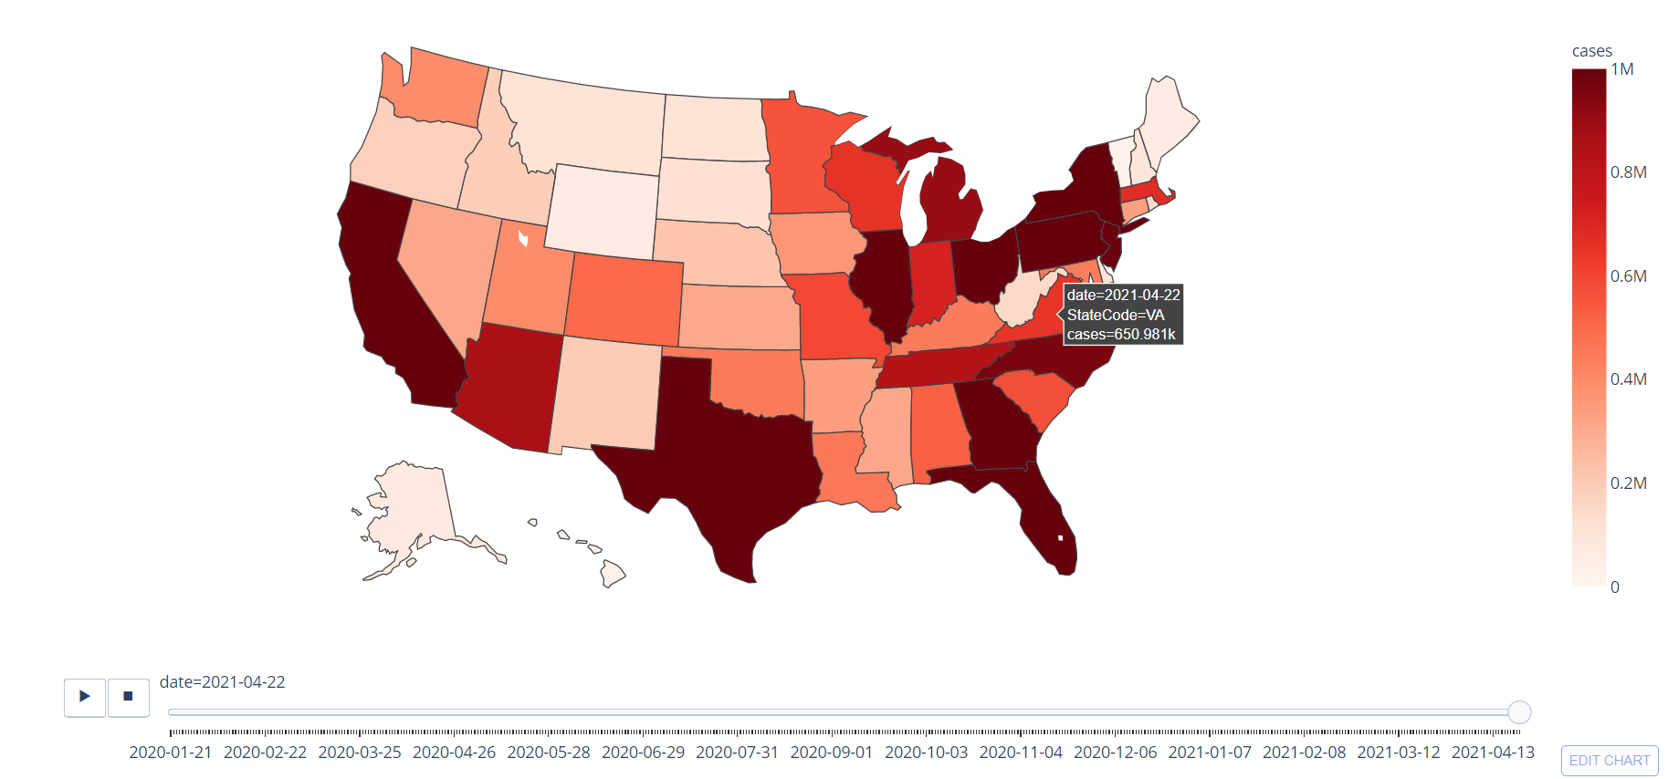
Cumulative Count of COVID-19 Cases in US States
6

Slide 7
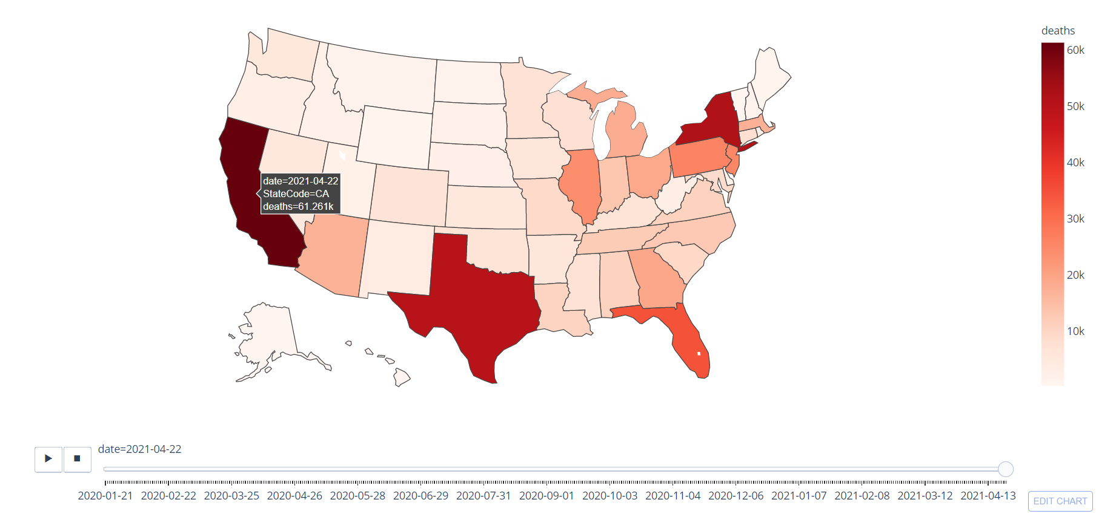
Cumulative Count of COVID-19 Deaths in US States
7

Slide 8
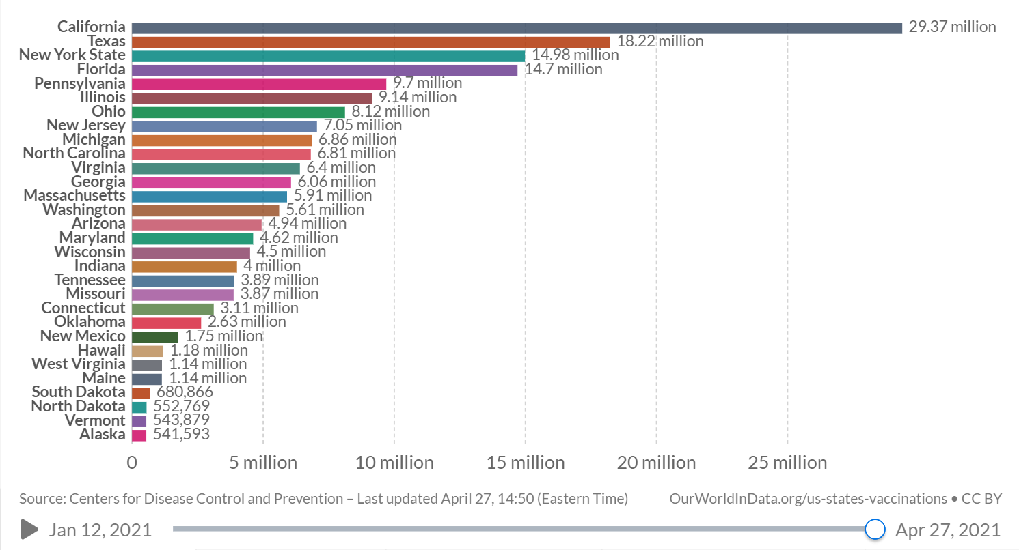
Total COVID-19 vaccine doses administered, Apr 27, 2021
8

Slide 9
Dataset
We focus only on 5 states:
New York, California (The top 2 in Deaths)
Virginia
Northern Mariana Islands, Virgin Islands (The lowest 2 in Deaths)
We build a different model for each state.

Slide 10
Pipeline
Converting daily numbers into cumulative.
Min-Max Scaler Normalization (-1.0 to +1.0).
Converting data into sliding windows (stride = 1).
Split data into 80:20 (Train:Test).
Feeding the data into the Neural Network Model (RNN or TST).
Training the neural network using Adam optimizer and MSE loss (Epochs = 100).
Testing the results and forecasting the future.
Inverse normalization and converting cumulative into daily numbers.

Slide 11
LSTM Model
LSTM
(hidden_size = 256)
LSTM
(hidden_size = 256)
LSTM
(hidden_size = 256)
Linear
(256, # of features)
[Batch, # of days, # of features]
Tanh
Sliding Window Size = 40
Features are (cases, deaths) or (vaccinations)
[Batch, 1, # of features]

Slide 12
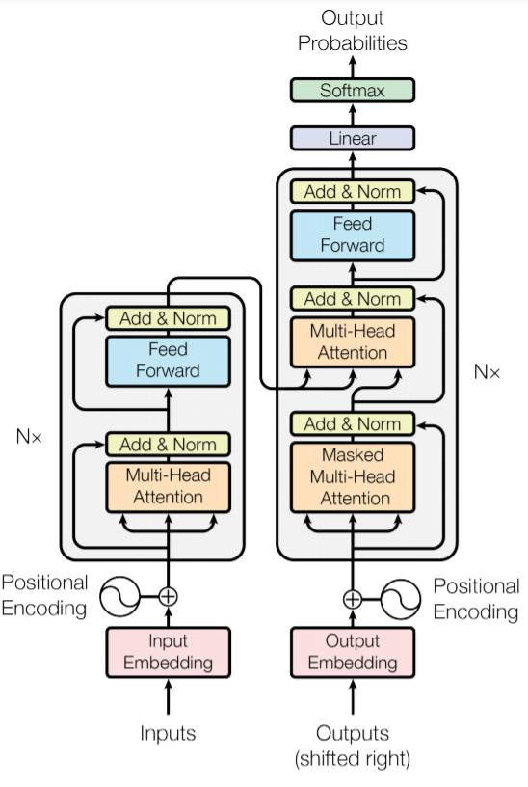
Transformer Model
The vanilla transformer is designed as a seq2seq problem (NMT Task).
Transformers are better than all the other architectures.
Totally avoid recursion and can be parallelized (Training is faster).
It can learn long-term temporal correlation relationships between words .
Transformer models utilizes a lot of tricks:
Positional Encoding or Embedding, Self-Attention, Multi-Head Attention, Masked Attention, Residual Connections, Layer Norm, Positional Feed Forward Network, No RNN cells at all.
We only use the encoder blocks; The decoder part is replaced with a linear layer.
Our task is modeled as a Natural Language Generation (NLG) task.
Source: Attention is all you need

Slide 13
Time-Series Transformer (TST) Model
[Batch, # of days, # of features]
TST
Encoder Blocks
(n_heads=4, n_hidden=256, n_layers=4 )
TST
Encoder Blocks
(n_heads=4, n_hidden=256, n_layers=4 )
TST
Encoder Blocks
(n_heads=4, n_hidden=256, n_layers=4 )
Linear
(# of features, 256)
Positional Encoding
Linear
(256, # of features)
The first linear layer replaces the embedding layer in the vanilla transformer.
The output layer has a Tanh or Sigmoid activation instead of SoftMax.
Sliding Window Size = 40
Features are (cases, deaths) or (vaccinations)
Tanh
[Batch, # of days, # of features]

Slide 14
Baselines
Prophet Models Reason for choosing:
1- Facebook’s modular regression-based model 2- Seasonal trends can be easily captured 3- Can be adjusted using domain knowledge 4- Robust to Outliers
SARIMA Model (Seasonal Autoregressive Integrated Moving Average) Reason for choosing:
1- Regression and moving average based model 2- Famous baseline for seasonal trends

Slide 15
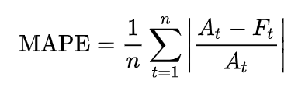
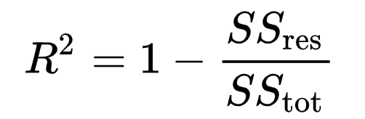
Evaluation Metric – Test Set
Mean absolute percentage error (MAPE)
It is commonly used as a loss function for regression problems and in model evaluation, because of its very intuitive interpretation in terms of relative error.
Lower is better
Coefficient of Determination (R2 Score)
It is one minus (The sum of squares of residuals divided by the total sum of squares)
It provides a measure of how well observed outcomes are replicated by the model, based on the proportion of total variation of outcomes explained by the model.
Higher is the better

Slide 16
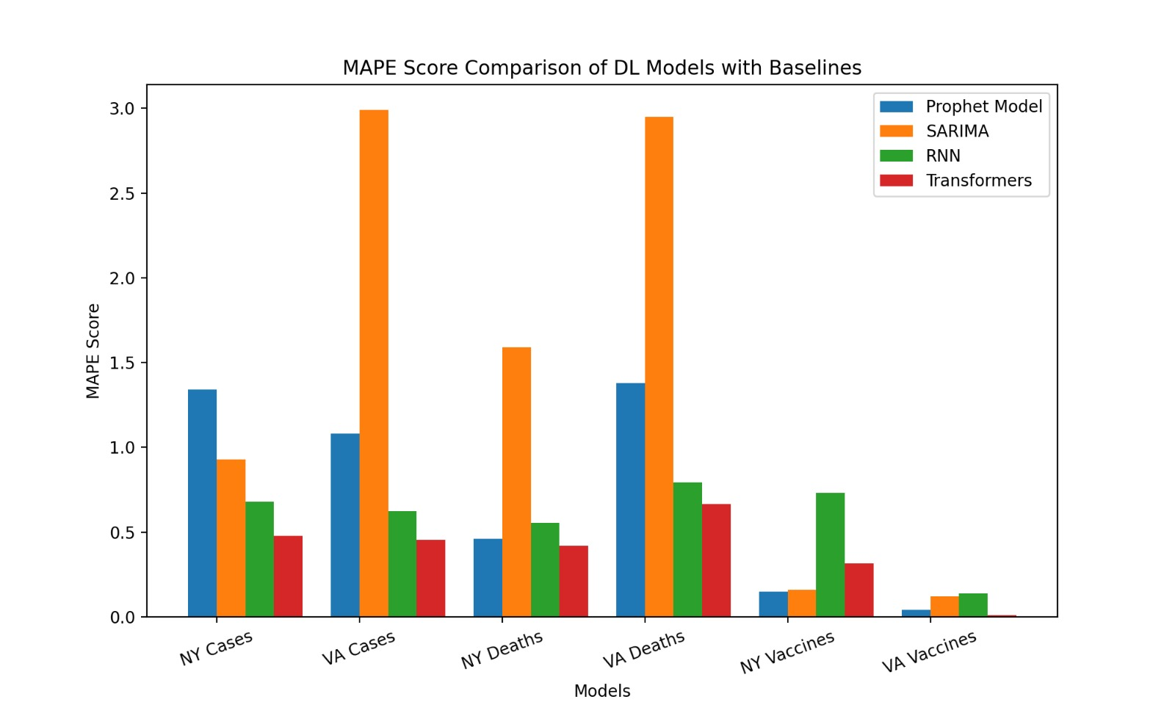
Evaluation Metric – Test Set
Notes:
transformers outperforms LSTM in most of the cases.

Slide 17
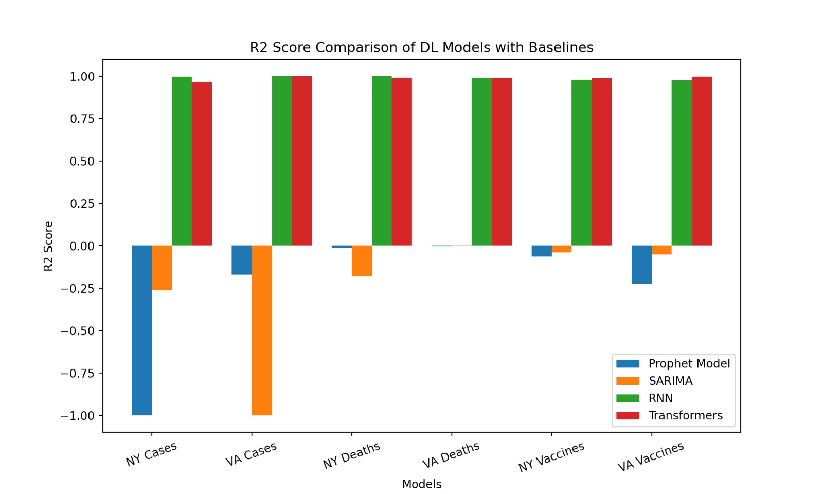
Evaluation Metric – Test Set
Find more of our results at this link

Slide 18
Test and Inference
Test and Inference

Slide 19
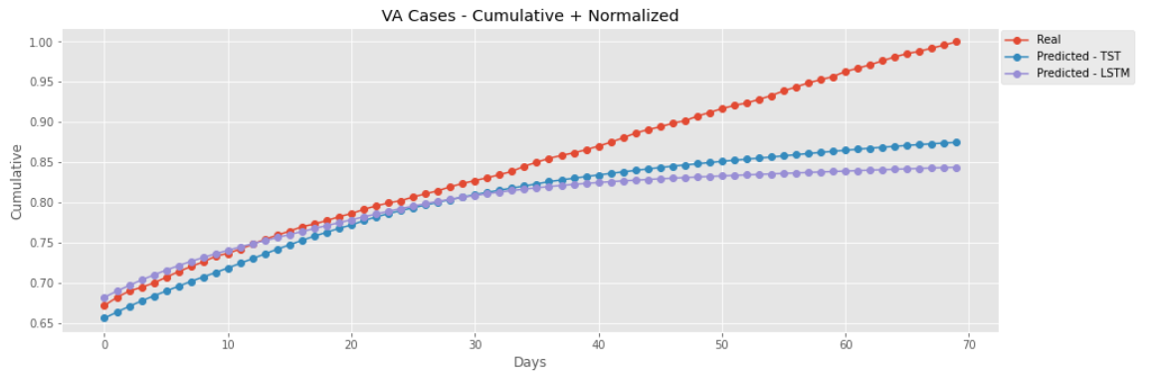
Some Results

Slide 20
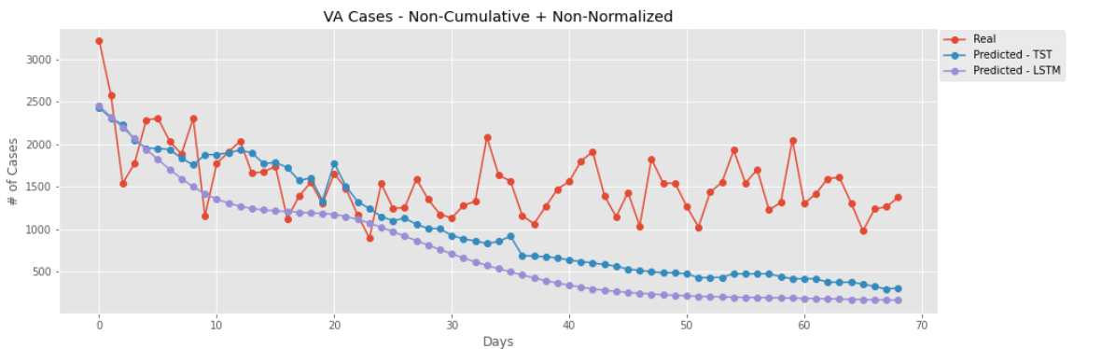
Some Results

Slide 21
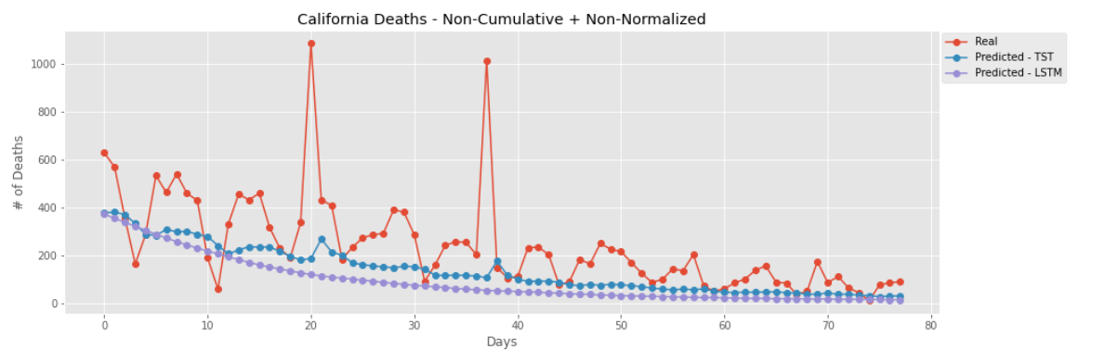
Some Results

Slide 22
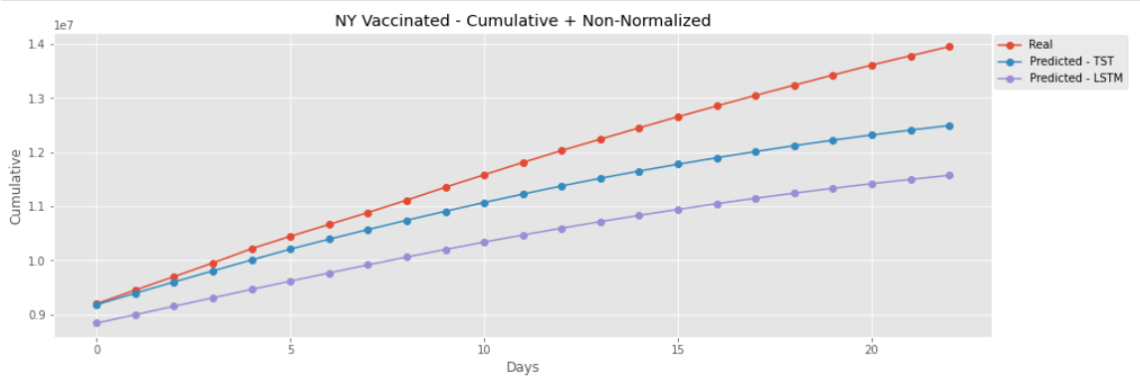
Some Results
Notes:
There is a few data

Slide 23
Future Work
Predicting the date that all people in the United States (per state) will be vaccinated.
Forecasting the results for the remaining of 2021.
Trying to train one time-series transformer model on the data from all states together.

Slide 24
Thanks for Listening!
Any Questions?

